Slide 1
Crowdsourcing High Quality Labels with a Tight Budget
Qi Li¹, Fenglong Ma¹, Jing Gao¹, Lu Su¹, Christopher J. Quinn²
¹SUNY Buffalo; ²Purdue University

Slide 2


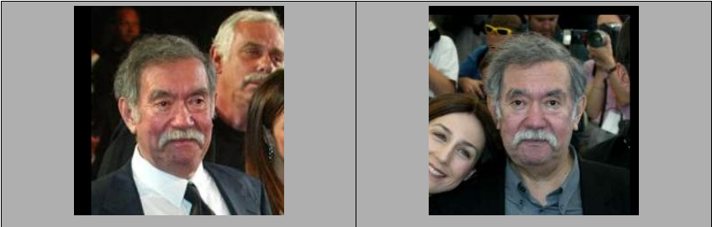



What is Crowdsourcing?
Terminology
Requester
Worker
HITs
Instance
Basic procedure
Requester posts HITs
Worker chooses HITs to work on
Requester gets labels and pay
Are the two images of the same person?
requester
…
Same
……
Same
Same
different

Slide 3
Budget Allocation
Since crowdsourcing costs money, we need to use the budget wisely.

Slide 4
Budget Allocation
Since crowdsourcing costs money, we need to use the budget wisely.
Budget allocation:
Which instance should we query for labels and how many?
Which worker should we choose?
Impossible on most current crowdsourcing platforms.

Slide 5






Challenges Under a Tight Budget
Quantity and Quality Trade-off
Different Requirements of Quality
Q1
Q2
Q3
Q1
Q2
Q3
I want my results are not randomly guessed.
or
Existing work would behave.
I will approve a result if more than 75% of the workers agree on that label.

Slide 6
Inputs and Goal
Inputs
Requester's requirement
The budget
T: the maximum amount of labels can be afforded
Goal
Label as many instances as possible which achieve the requirement under the budget

Slide 7
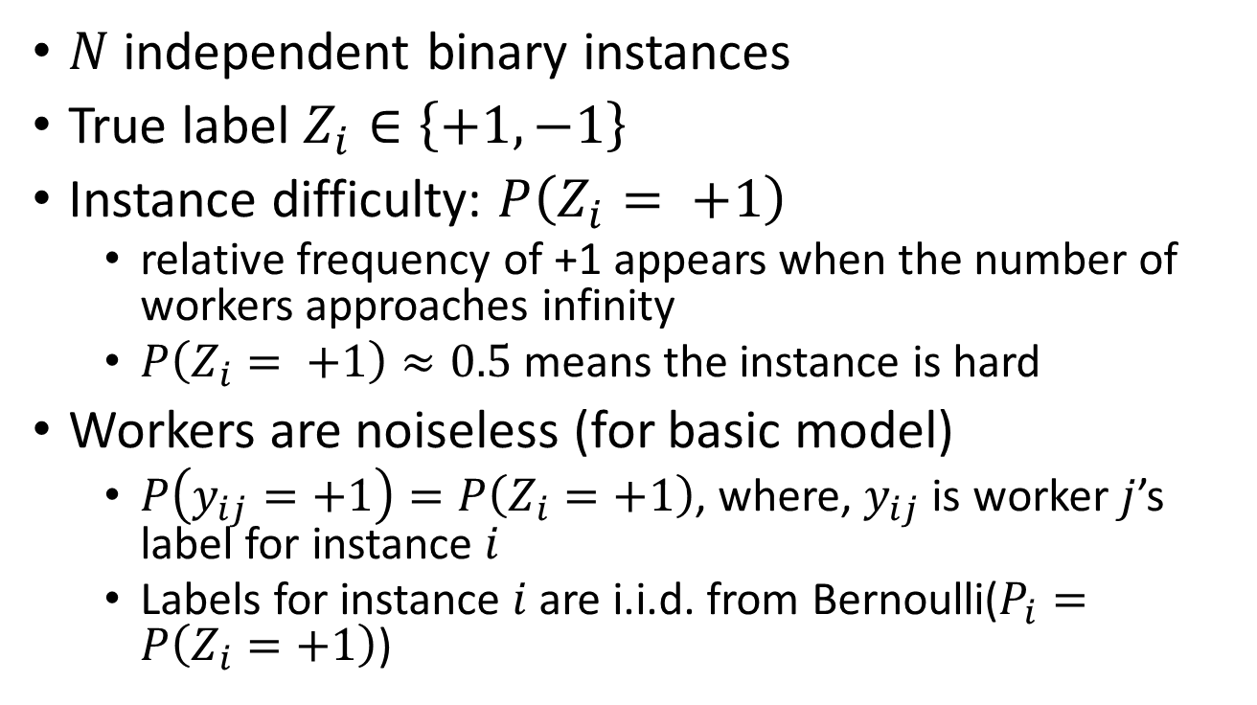
Problem Settings
$N$ independent binary instances
True label $Z_{i}∈\left\{+1, −1\right\}$
Instance difficulty: $P\left(Z_{i}= +1\right)$
relative frequency of +1 appears when the number of workers approaches infinity
$P\left(Z_{i}= +1\right)≈0.5$ means the instance is hard
Workers are noiseless (for basic model)
$P\left(y_{ij}=+1\right)=P\left(Z_{i}=+1\right)$, where, $y_{ij}$ is worker $j$’s label for instance $i$
Labels for instance $i$ are i.i.d. from Bernoulli($P_{i}=P\left(Z_{i}=+1\right)$)

Slide 8
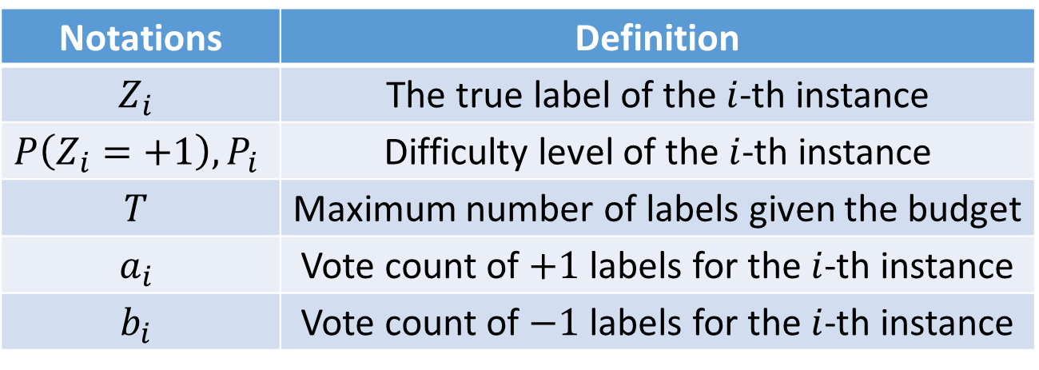
Notations
Notations | Definition
$$Z_{i}$$ | The true label of the $i$-th instance
$$P\left(Z_{i}=+1\right), P_{i}$$ | Difficulty level of the $i$-th instance
$$T$$ | Maximum number of labels given the budget
$$a_{i}$$ | Vote count of $+1$ labels for the $i$-th instance
$$b_{i}$$ | Vote count of $−1$ labels for the $i$-th instance

Slide 9
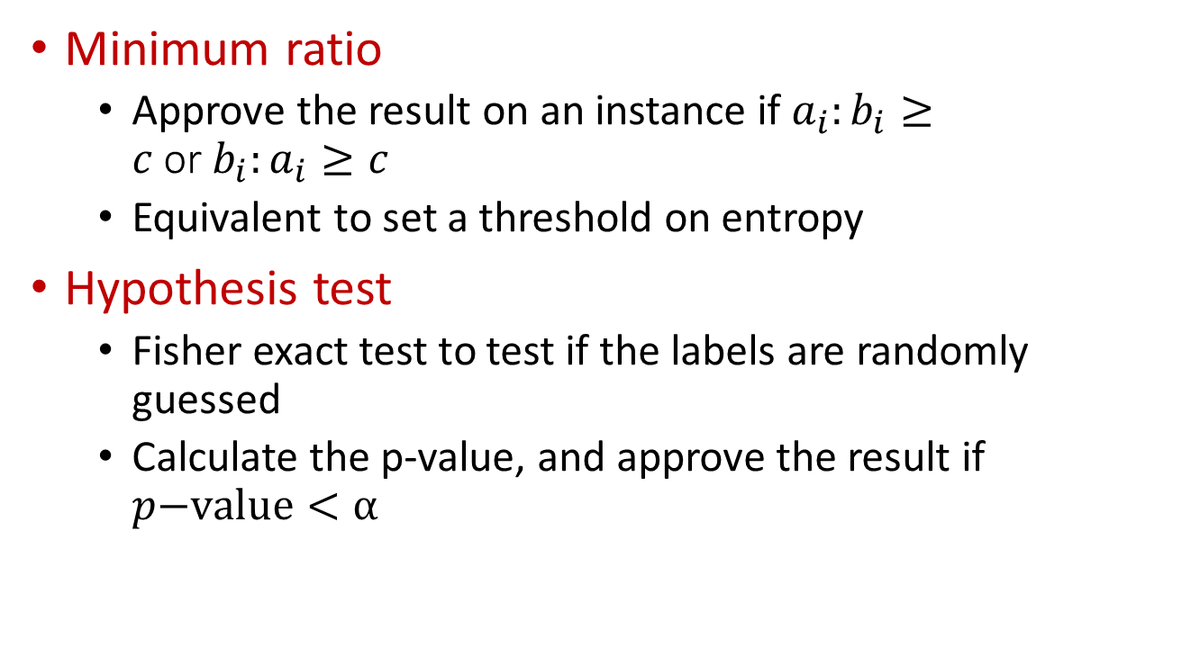
Examples of Requirement
Minimum ratio
Approve the result on an instance if $a_{i}:b_{i}≥c$or$b_{i}:a_{i}≥c$
Equivalent to set a threshold on entropy
Hypothesis test
Fisher exact test to test if the labels are randomly guessed
Calculate the p-value, and approve the result if $p\text{−}\text{value}<α$

Slide 10
Completeness
Ratio between the observed total vote counts and the minimum count of labels it needs to achieve the requirement.

Slide 11
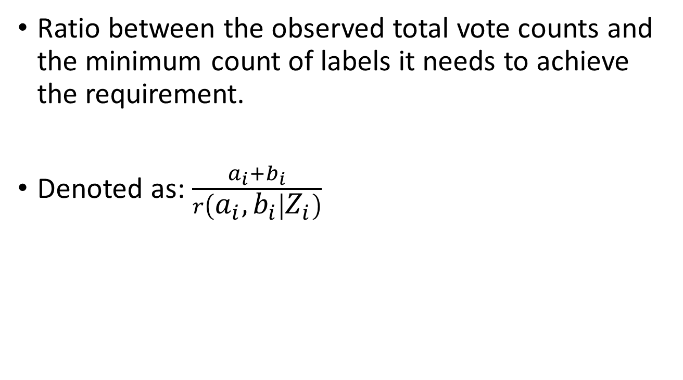
Completeness
Ratio between the observed total vote counts and the minimum count of labels it needs to achieve the requirement.
Denoted as: $\frac{a_{i}+b_{i}}{r\left(a_{i}, b_{i} | Z_{i}\right)}$
Observed total vote counts
Minimum count to achieve the requirement

Slide 12
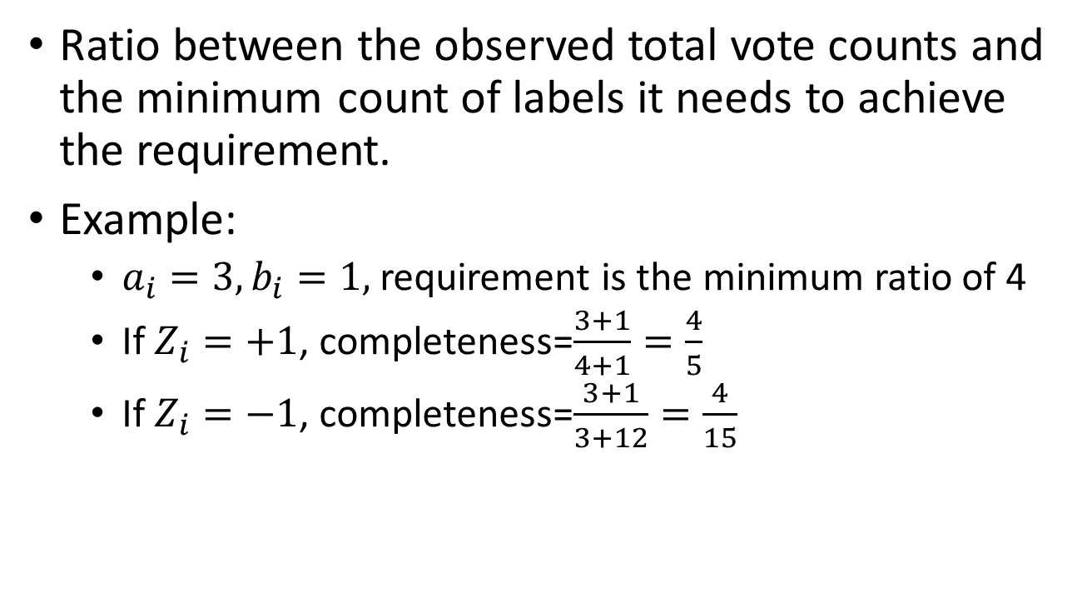
Completeness
Ratio between the observed total vote counts and the minimum count of labels it needs to achieve the requirement.
Example:
$a_{i}=3, b_{i}=1,$requirement is the minimum ratio of 4
If $Z_{i}=+1$, completeness=$\frac{3+1}{4+1}=\frac{4}{5}$
If $Z_{i}=−1$, completeness=$\frac{3+1}{3+12}=\frac{4}{15}$

Slide 13
Maximize Completeness
The goal is to label instances as many as possible that achieve the requirement of quality.

Slide 14
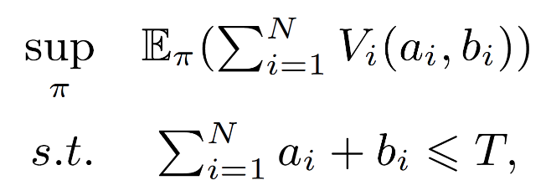
Maximize Completeness
The goal is to label instances as many as possible that achieve the requirement of quality.
Maximize the overall completeness
Formally:

Slide 15
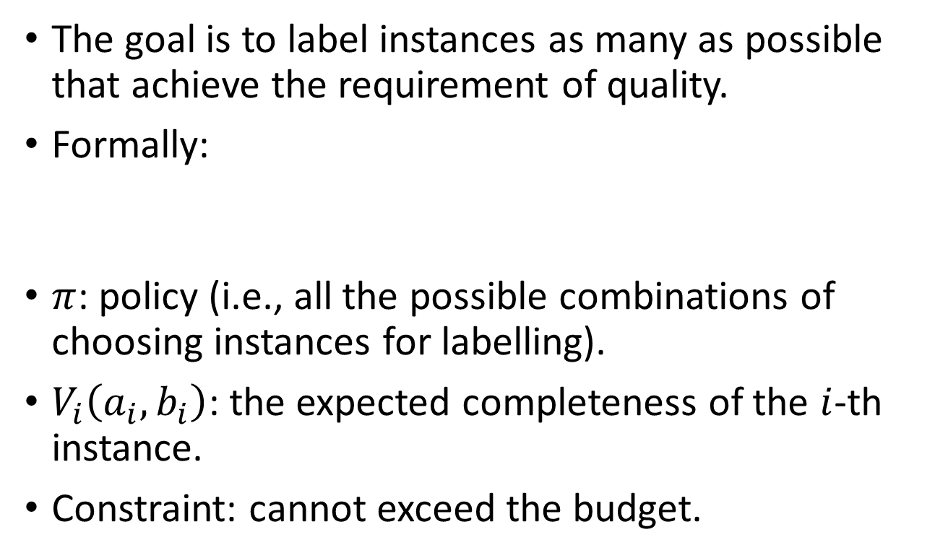
Maximize Completeness
The goal is to label instances as many as possible that achieve the requirement of quality.
Formally:
$π$: policy (i.e., all the possible combinations of choosing instances for labelling).
$V_{i}\left(a_{i}, b_{i}\right)$: the expected completeness of the $i$-th instance.
Constraint: cannot exceed the budget.

Slide 16
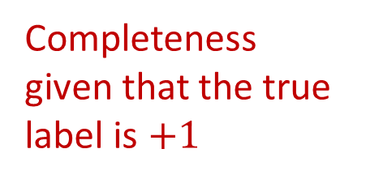
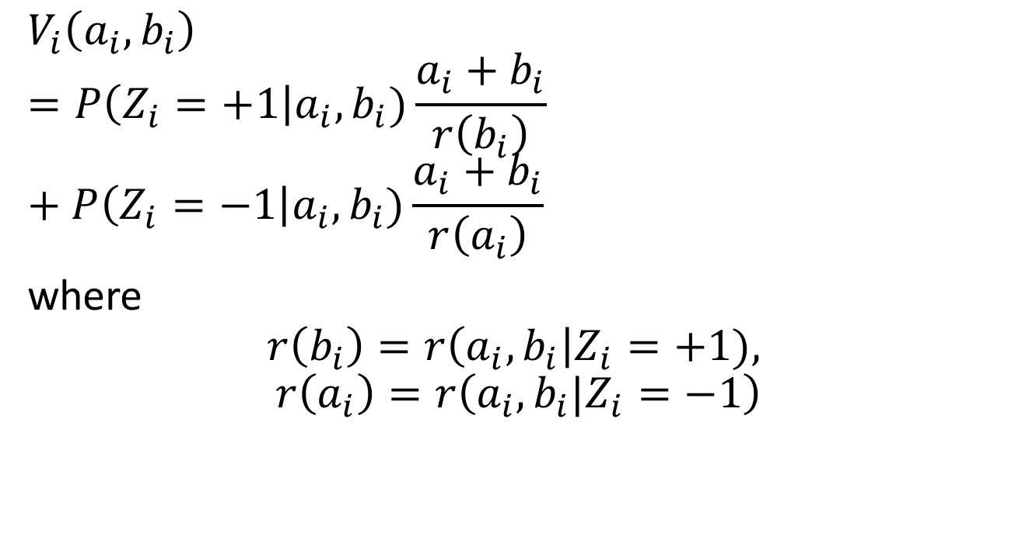
Expected Completeness
$$V_{i}\left(a_{i}, b_{i}\right)=P\left(Z_{i}=+1\right|a_{i}, b_{i})\frac{a_{i}+b_{i}}{r\left(b_{i}\right)}+P\left(Z_{i}=−1\right|a_{i}, b_{i})\frac{a_{i}+b_{i}}{r\left(a_{i}\right)}$$
where
$$r\left(b_{i}\right)=r\left(a_{i},b_{i}\right|Z_{i}=+1),$$
$$r\left(a_{i}\right)=r\left(a_{i}, b_{i}|Z_{i}=−1\right)$$
Completeness given that the true label is $+1$

Slide 17
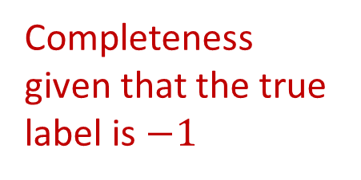
Expected Completeness
$$V_{i}\left(a_{i}, b_{i}\right)=P\left(Z_{i}=+1\right|a_{i}, b_{i})\frac{a_{i}+b_{i}}{r\left(b_{i}\right)}+P\left(Z_{i}=−1\right|a_{i}, b_{i})\frac{a_{i}+b_{i}}{r\left(a_{i}\right)}$$
where
$$r\left(b_{i}\right)=r\left(a_{i},b_{i}\right|Z_{i}=+1),$$
$$r\left(a_{i}\right)=r\left(a_{i}, b_{i}|Z_{i}=−1\right)$$
Completeness given that the true label is$−1$

Slide 18
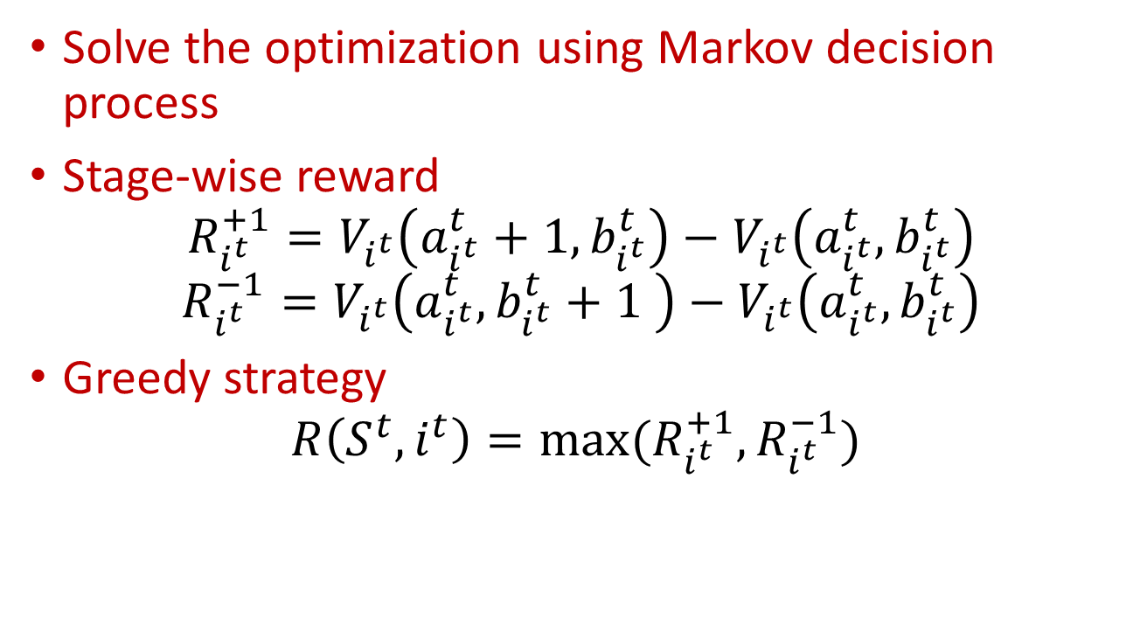
Markov Decision Process
Solve the optimization using Markov decision process
Stage-wise reward
$$R_{i^{t}}^{+1}=V_{i^{t}}\left(a_{i^{t}}^{t}+1, b_{i^{t}}^{t}\right)−V_{i^{t}}\left(a_{i^{t}}^{t}, b_{i^{t}}^{t}\right)$$
$$R_{i^{t}}^{−1}=V_{i^{t}}\left(a_{i^{t}}^{t}, b_{i^{t}}^{t}+1 \right)−V_{i^{t}}\left(a_{i^{t}}^{t}, b_{i^{t}}^{t}\right)$$
Greedy strategy
$${R\left(S^{t},i^{t}\right)=max⁡(R}_{i^{t}}^{+1},R_{i^{t}}^{−1})$$

Slide 19




Requallo Framework
Requirement: Minimum Ratio of 3
Q1
+1
+1
-1
+1
Q2
-1
+1
+1
Q3
-1
+1

Slide 20
Requallo Framework
Requirement: Minimum Ratio of 3
Q1
Completeness
100%
+1
+1
-1
+1
Q2
Completeness
72%
-1
+1
+1
Q3
Completeness
50%
-1
+1

Slide 21

Requallo Framework
Requirement: Minimum Ratio of 3
Q1
Completeness
100%
+1
+1
-1
+1
Q2
Completeness
72%
-1
+1
+1
Reward
Q3
Completeness
50%
-1
+1
Reward

Slide 22
Requallo Framework
Requirement: Minimum Ratio of 3
Q1
Completeness
100%
+1
+1
-1
+1
Q2
Completeness
72%
-1
+1
+1
Selected
Reward
Q3
Completeness
50%
-1
+1
Unselected
Reward

Slide 23
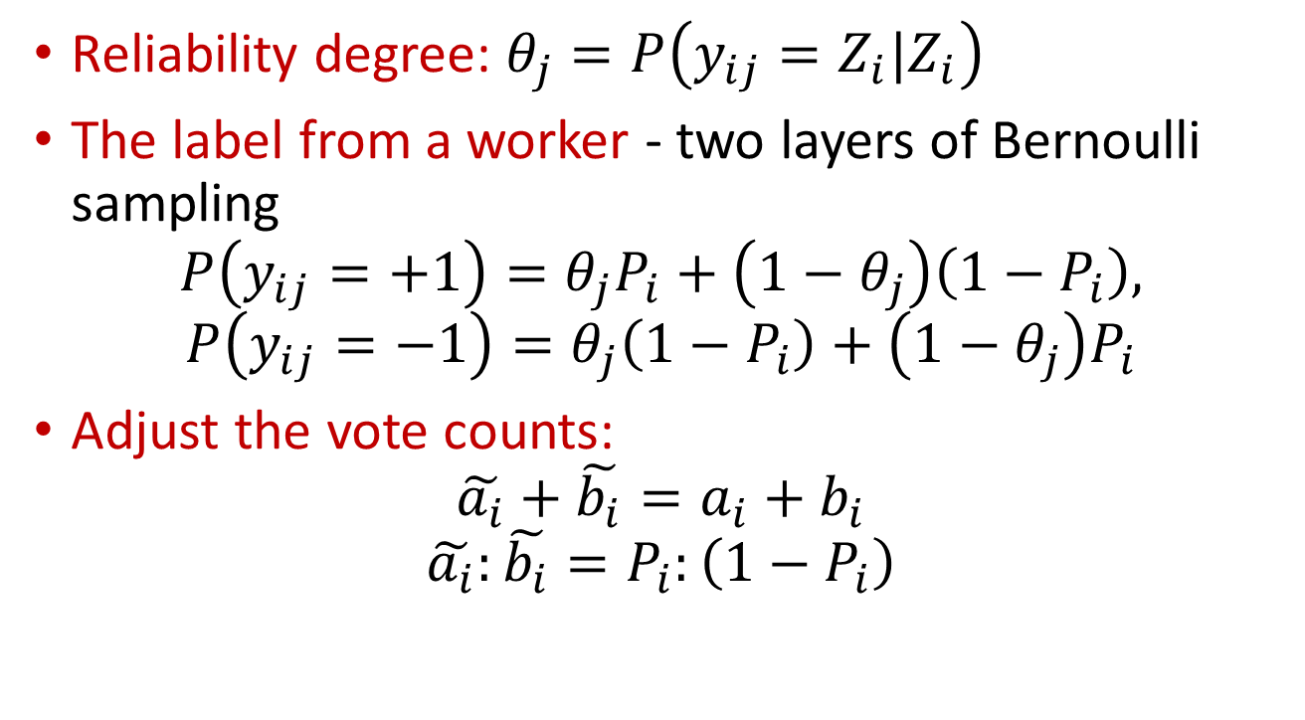
Extension: Workers’ Reliability
Reliability degree: $θ_{j}=P\left(y_{ij}=Z_{i}|Z_{i}\right)$
The label from a worker - two layers of Bernoulli sampling
$$P\left(y_{ij}=+1\right)=θ_{j}P_{i}+\left(1−θ_{j}\right)\left(1−P_{i}\right),$$
$$P\left(y_{ij}=−1\right)=θ_{j}\left(1−P_{i}\right)+\left(1−θ_{j}\right)P_{i}$$
Adjust the vote counts:
$$\tilde{a_{i}}+\tilde{b_{i}}=a_{i}+b_{i}$$
$$\tilde{a_{i}}:\tilde{b_{i}}=P_{i}:\left(1−P_{i}\right)$$

Slide 24
Experiments on Real-World Crowdsourcing Tasks
Dataset
RTE dataset: conducted on mTurk for recognizing textual entailment
Game Dataset: conducted using an Android app based on a TV game show “Who Wants to Be a Millionaire“
Performance Measures
Quantity
Quality

Slide 25
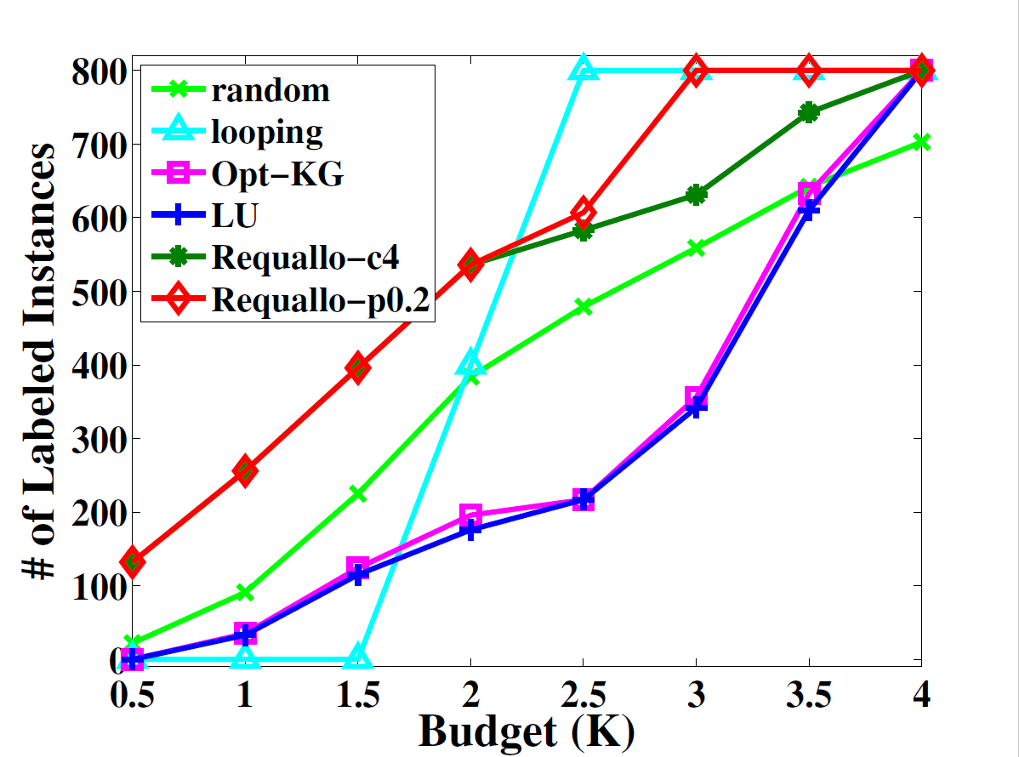
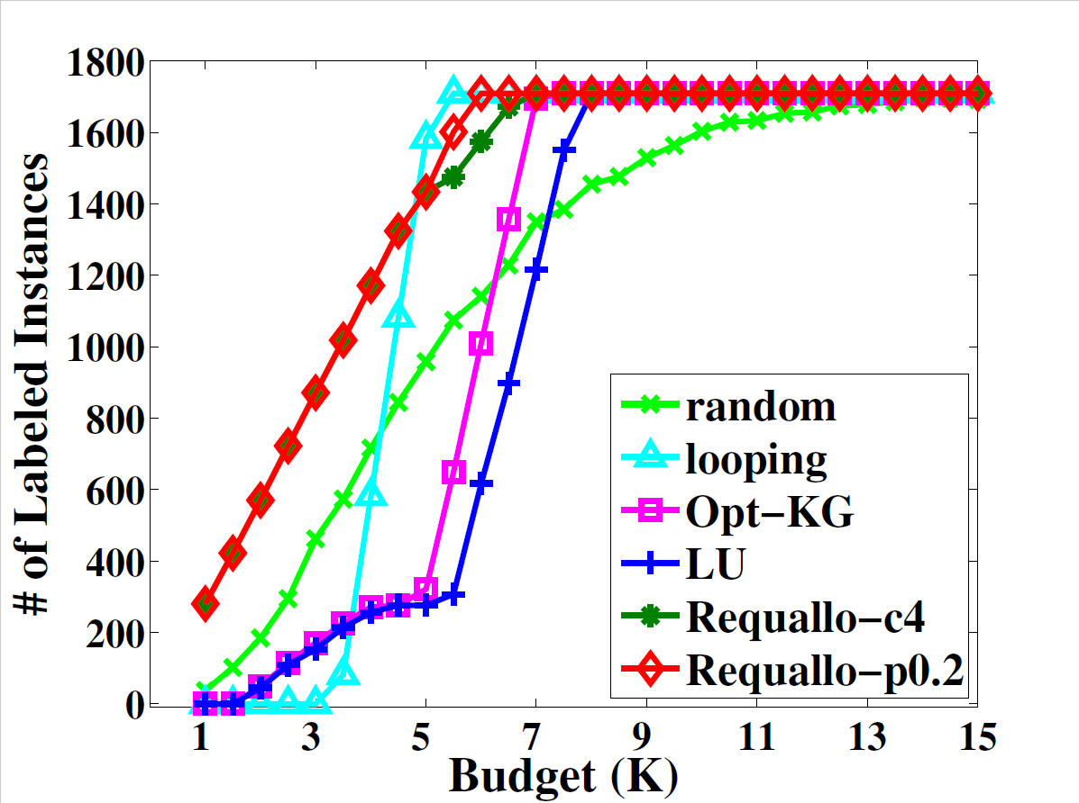
Experiments on Real-World Crowdsourcing Tasks
RTE Dataset
Game Dataset
Quantity
Quantity

Slide 26
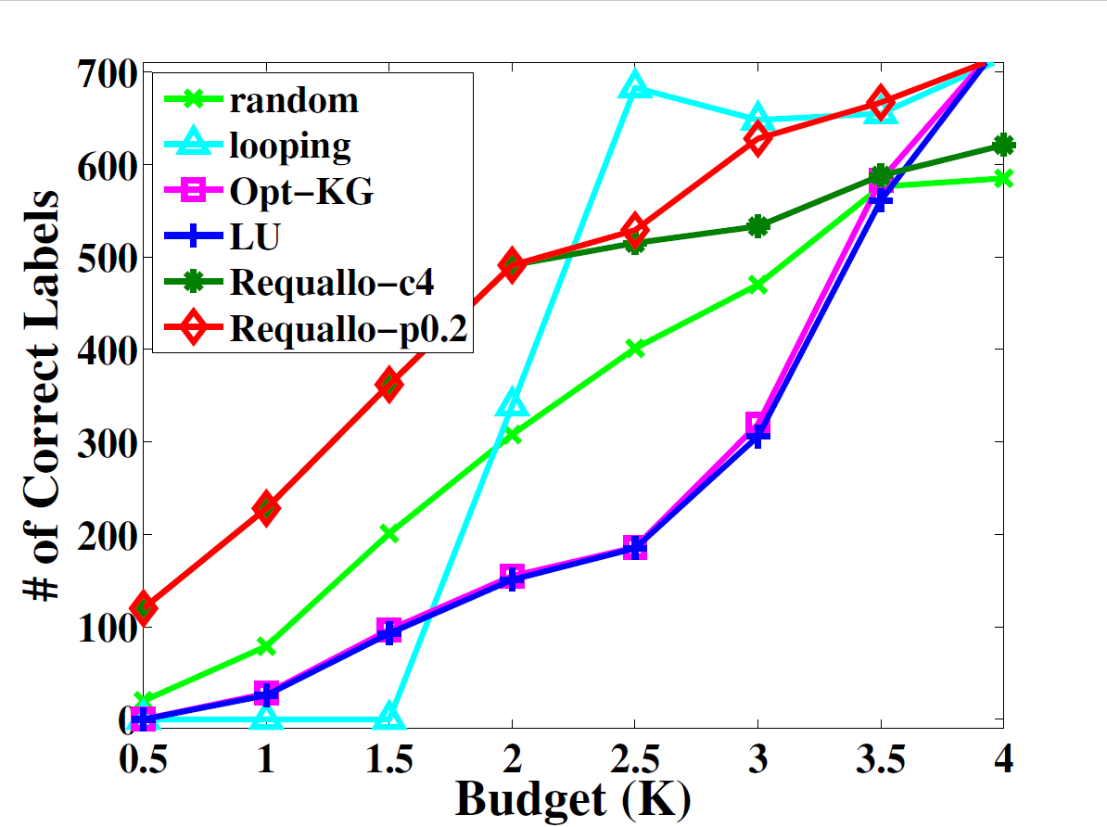
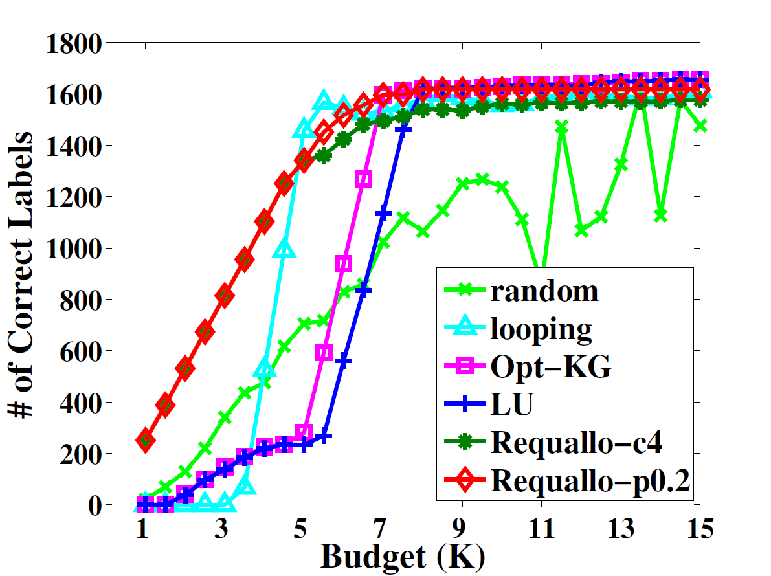
Experiments on Real-World Crowdsourcing Tasks
RTE Dataset
Game Dataset
Absolute count
Absolute count

Slide 27
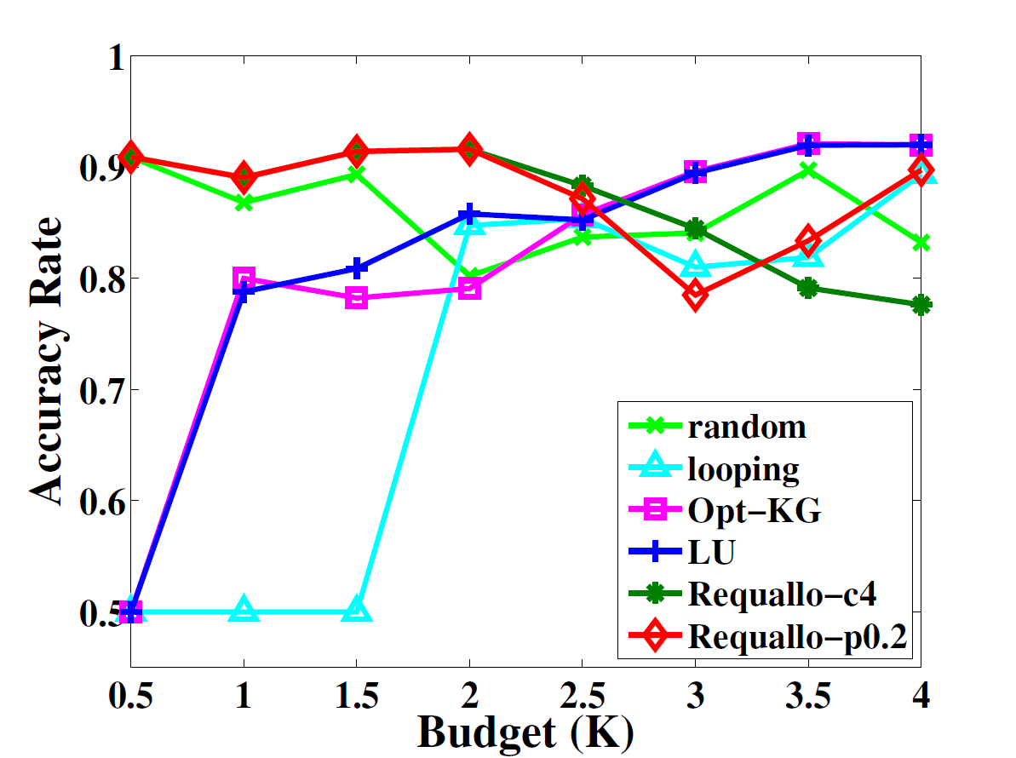
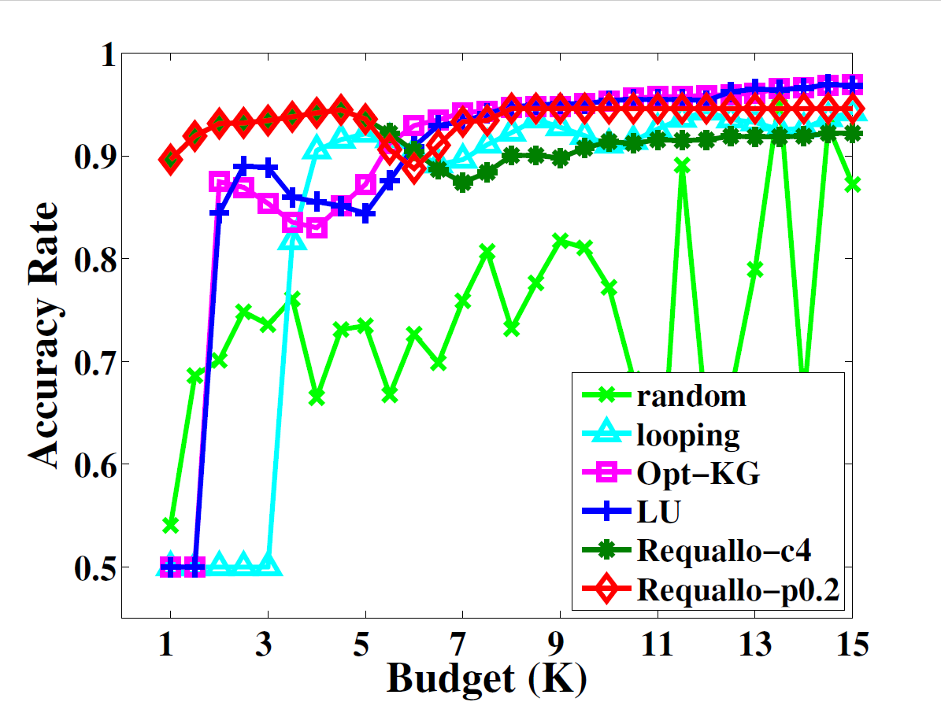
Experiments on real-world crowdsourcing tasks
RTE Dataset
Game Dataset
Accuracy rate
Accuracy rate

Slide 28
Comparison of Different Requallo Policies (on Game dataset)
Method | Cost | #Instances | #Correct | Accuracy
Requallo-p0.2 | 7715 | 1662 | 1587 | 0.9549
Requallo-p0.1 | 11191 | 1597 | 1558 | 0.9756
Requallo-p0.05 | 13878 | 1517 | 1493 | 0.9842
Requallo-c4 | 8689 | 1567 | 1518 | 0.9687
Requallo-c5 | 11266 | 1489 | 1464 | 0.9832
Requallo-m3 | 5127 | 1709 | 1580 | 0.9245
This result confirms our intuition.
If a requester wants high quality results, he can set a strict requirement, but should expect a lower quantity of labeled instances or a higher cost.

Slide 29
Conclusions
In this paper, we study how to allocate a tight budget for crowdsourcing tasks
The requesters can specify their needs on label quality
The goal is to maximize quantity under the budget while guarantee the quality
The proposed Requallo framework uses greedy strategy to sequentially label instances.
Extension to incorporate workers’ reliabilities.

Slide 30
Thank You!

